Slide 1
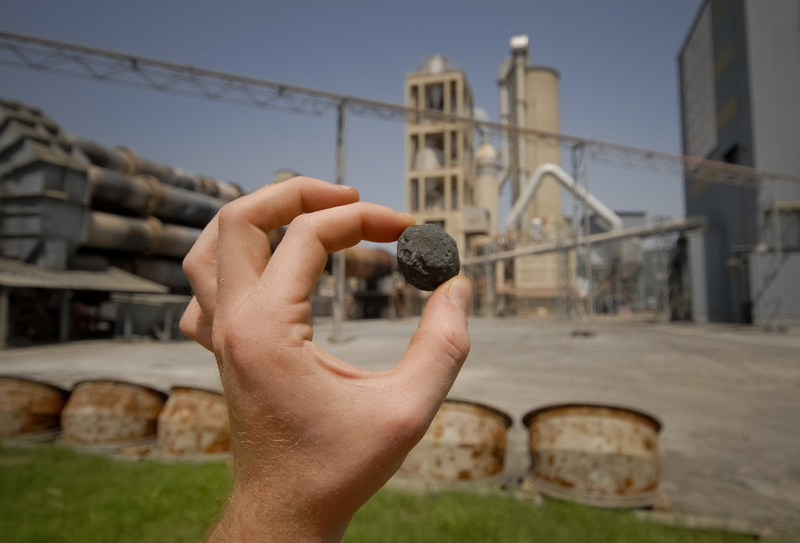
Clinker Characteristics and Burning Behavior
PPE Course

Slide 2
Objectives
Provide understanding for the relationship between raw meal, fuel and clinker characteristics and burning behavior
Provide guidelines for appropriate ranges of chemical moduli and minor elements
Present tools for assessment and optimization of burning behavior and clinker properties respectively reactivity
2

Slide 3
Agenda
Clinker Formation and Burning: A short Overview
5
Appropriate ranges of chemical module and minor elements
17
Burnability test: Application for Raw Mix Optimization
35
Clinker Granulation and Coating Formation
48
Clinker Microscopy: A Diagnostic Tool
62
Conclusions
69

Slide 4
Clinker Formation and Burning: A short Overview

Slide 5
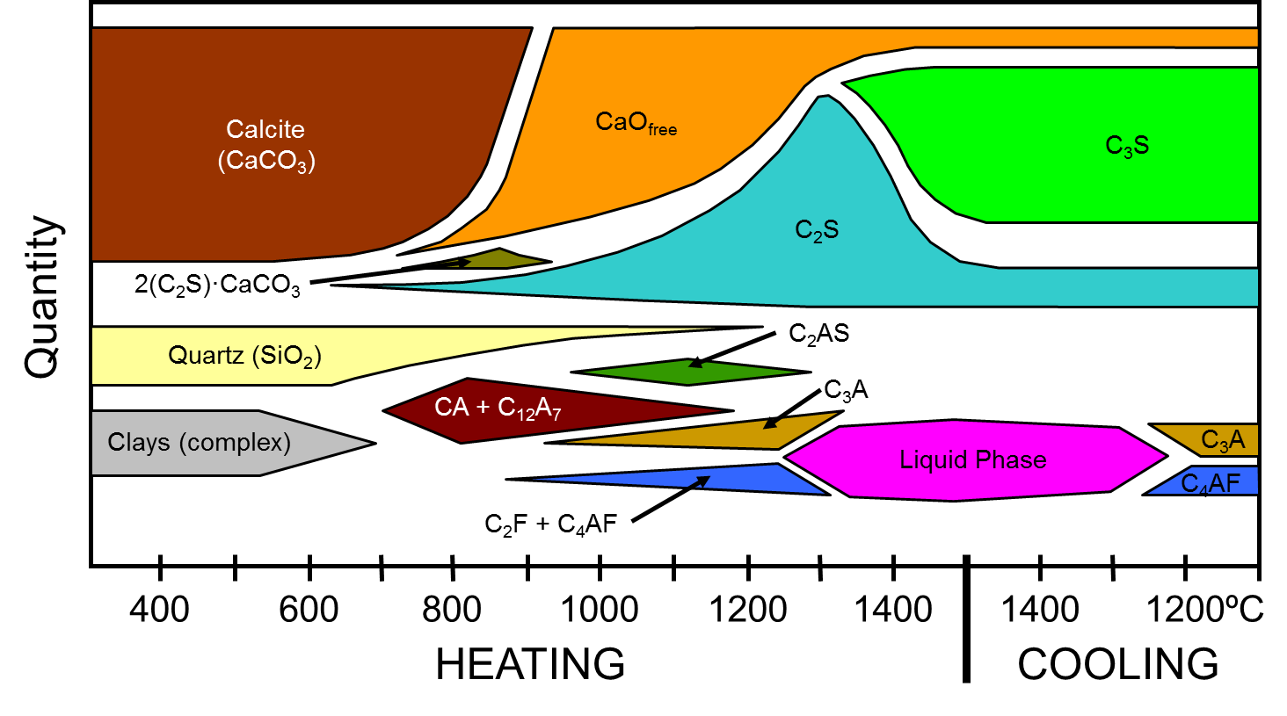
Quasi Quantitative Variation of Minerals with Temperature
Free Lime
Alite
Belite
Aluminate
Ferrite
5

Slide 6
Sequence of Reactions Occurring in a Rotary Kiln System
Heating (°C)
20 - 100 Evaporation of H₂O
100 - 300 Loss of physically adsorbed water
400 - 900 Removal of structural H₂O (H₂O and OH groups) from clay minerals
>500 Structural changes in silicate minerals
600 - 900 Dissociation of carbonates
>800 Formation of belite, intermediate products, aluminate and ferrite
>1250 Formation of liquid phase (aluminate and ferrite melt)
~1450 Completion of reaction and growth of alite and belite
Cooling (°C)
1300 - 1240 Crystallization of liquid phase into mainly aluminate and ferrite
6

Slide 7
Clinker Formation: Energy requirement (dry process)
T [°C] | Type of Reaction | kJ/kgclinker
0 - 1450 | Heating of raw materials | ≈ | 2050
400 - 900 | Dehydration of clays | ≈ | 170
600 - 900 | Decarbonization of calcite | ≈ | 1990
> 800 > 1250 for Alite | Heat of formation of clinker minerals | ≈ | - 420
> 1250 | Heat of melting | ≈ | 105
 | Crystallization of dehydrated clay | ≈ | - 40
1300 - 1240 | Crystallization of melt | ≈ | - 105
< 1240 | Cooling of clinker | ≈ | - 1'400
 | Cooling of CO₂ (ex calcite) | ≈ | - 500
 | Cooling of H₂O (ex clays) | ≈ | - 85
Net theoretical heat of clinker formation |  |  | + 1765
7

Slide 8
Burning Behavior
In addition to the clinker formation process, several additional chemical and physical reaction take place in the kiln system.
8

Slide 9
Burning Behavior
 | Raw Meal Chemical Composition Fineness Microhomogeneity Uniformity | Fuel Ash Content and Composition SO3 Contents Operational Conditions Production Rate Temperature Profile Residence time Dust Return Uniformity of Operation: Kiln Feed Fuel Rate Gas Rate
Kiln System Type of: Kiln, Preheater Precalciner, Cooler Dimensions Heat exchanger Refractory Lining | BURNABILITY BURNING BEHAVIOR
9

Slide 10
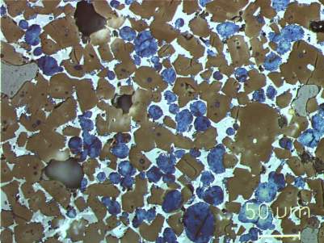
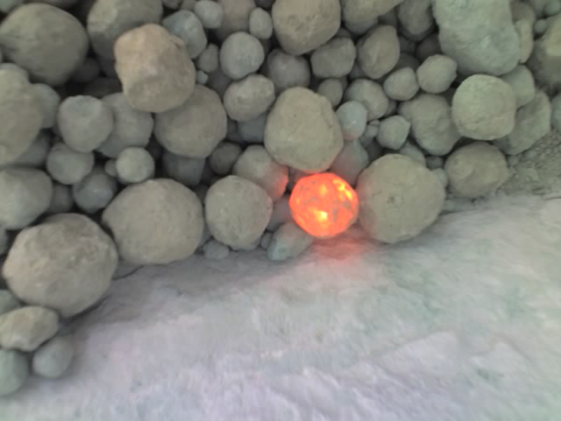
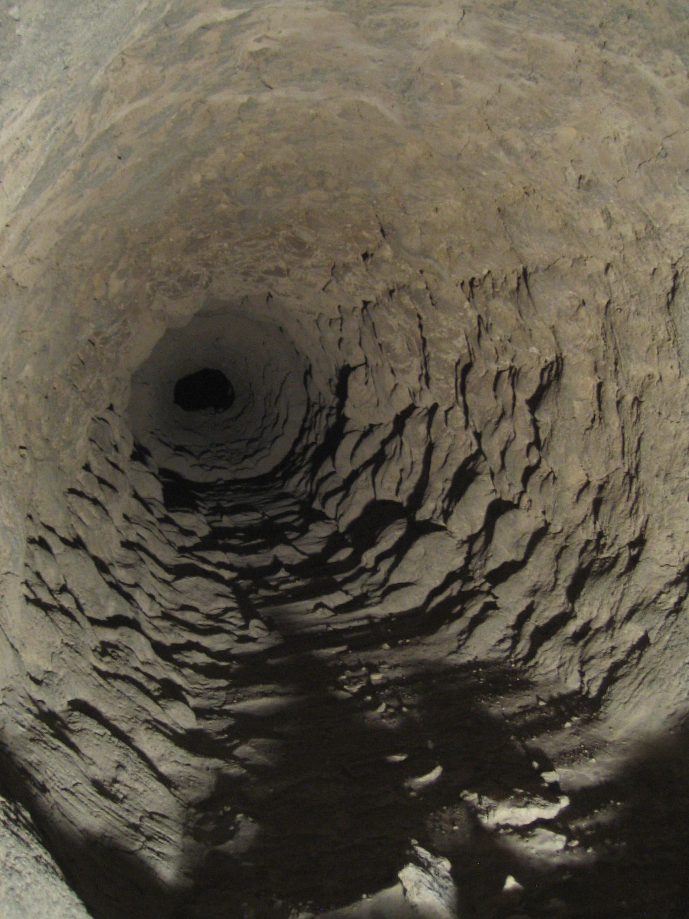
Significance of Liquid Phase
Acts as a solvent (transport medium) and facilitates Alite formation
Enables clinker granulation
Enables coating formation (but also ring formation)
10

Slide 11
Liquid Phase
Most raw mixes show similar minimum temperature of liquid formation (eutectic point), but the quantity of liquid formed at which temperatures varies with raw mix chemistry.
For OPC clinker, the eutectic melting point is at 1338°C; the composition of the liquid is:
CaO - 55 %
SiO₂ - 6 % Alumina ratio
Al₂O₃ - 22 % (AR) = 1.38
Fe₂O₃ - 16 %
11

Slide 12
Calculation of Liquid Phase Quantity
Formulae for quantitative calculation acc. to LEA
1338 ºC = 6.1 Fe₂O₃ + MgO + Na₂O + K₂O if AR ≥ 1.38
8.2 Al₂O₃ – 5.22 Fe₂O₃ + MgO + Na₂O + K₂O if AR ≤1.38
1400 ºC = 2.95 Al₂O₃ + 2.2 Fe₂O₃ + MgO + Na₂O + K₂O for MgO ≤ 2%
1450 ºC = 3.0 Al₂O₃ + 2.25 Fe₂O₃ + MgO + Na₂O + K₂O for MgO ≤ 2%
Typical calculated quantities at 1400 °C: 20 to 30 %
% liquid phase | Characterization
< 23% | dry
23-27% | normal
> 27% | wet
12

Slide 13
Amount of Liquid: Effect of Chemistry
AR indicates the amount of liquid formed early, at relatively low temperatures (max at AR 1.38)
35
30
SR = 2.04 AR = 1.44
LA
SR = 2.48 AR = 2.49
25
SR = 2.53 AR = 0.93
%
TR
SR = 3.29 AR = 1.33
20
MI
15
CA
10
1338
1400
1450
°C
13

Slide 14
Amount of Liquid: Effect of Chemistry
SR indicates the final amount of liquid formed (higher SR = less liquid)
14

Slide 15
Quantity of Liquid Phase: Correlation with SR
Data from Holcim Industrial clinkers (Product handbook)
15

Slide 16
Appropriate ranges of chemical module and minor elements

Slide 17
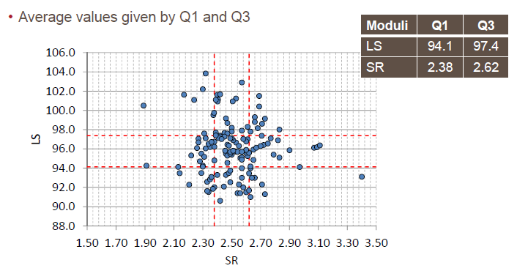
Chemical Moduli in Holcim Clinker (ATR 2014)
17

Slide 18
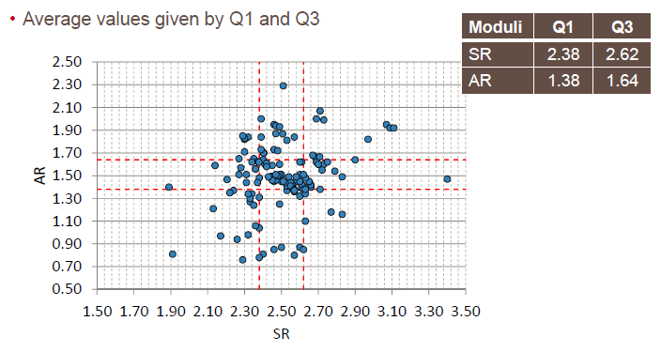
Chemical Moduli in Holcim Clinker (ATR 2014)
18

Slide 19
Clinker Chemical Moduli
Industrial clinkers concentrate in the following range of chemical moduli (Like-For-Like)
A normal burning behavior and clinker quality can be expected from clinkers within this range.
Moduli | Typical range | avg ATR 2002 | avg ATR 2010 | avg ATR 2012
LS | 94 – 98 | 96.0 | 95.4 | 96.0
SR | 2.35 – 2.75 | 2.58 | 2.50 | 2.53
AR | 1.4 – 1.8 | 1.58 | 1.50 | 1.50
19

Slide 20
Clinker Chemical Moduli (cont)
Deviations from the ‘normal’ ranges can be due to:
Need for high clinker strength potential to maximize clinker substitution or to meet market needs:
LS > 98, SR > 2.75, AR > 1.8 (+/- mineralization)
Plant specific optimization of burning behavior
Specific composition of main raw mix components
Lack of correctives, minimization of components
Shortage of sufficiently high grade limestone
In case of unsatisfactory burning behavior or quality: search for correctives, incl. AR
Limit of C₃A content (Sulfate-resistant cement): AR < 1.4
20

Slide 21
Design of mineralized clinker (Holcim Method)
Typical ranges for mineralized clinker:
LSF: 101 –103
SR: 2.6 – 3.0
AR: 1.6 – 2.0
C₃S: > 70% (Bogue); > 75% (Microscopy)
Liquid phase: 23 – 25%
F: 0.23 ± 0.02%
Free lime: < 2%
Kiln feed burnability (according to Holcim test):
Moderate to good
21

Slide 22
Clinker mineralization with fluoride facilitates the production of clinker with alite contents up to 80 %
The addition of F improves clinker burnability. This effect can be exploited by increasing the LS of kiln feed to achieve very high alite contents in clinker.
F is typically sourced from natural fluorspar. Alternative sources can be spent cell liners (SPL).
Possible benefits which can be obtained from such more reactive clinker are as follows:
Decrease of clinker factor
Reduction of cement production costs
Improvement of cement quality
Increase of cement production volume (at constant clinker capacity)
Reduction of specific CO₂ emissions
Improved SO₃ incorporation
22

Slide 23
Mineralizers
“Mineralizers change the chemical potential G of the reactants: when the mineralizer enters into solid solution of the educts the rate (of the forward reaction) is decreased, when it enters into solid solution in the product the rate is increased.”
Most of impurities are more soluble in belite than in alite
But F is more soluble in alite than in belite
Substitution of O by F in the crystal lattice of alite increases disorder and thereby improves hydraulic reactivity

Slide 24
Principle of F-mineralization - thermodynamics
Chemical potential of pure CaO, C₂S and C₃S at 1100° C
Chemical potential of CaO, C₂S and F-containing C₃S at 1100° C
CaO C₃S C₂S
CaO F-C₃S C₂S
G
G
CaO SiO₂
CaO SiO₂
CaO and C₂S stable at 1100° C
CaO and C₃S stable at 1100° C
C₃S and C₂S stable at 1100° C
24

Slide 25
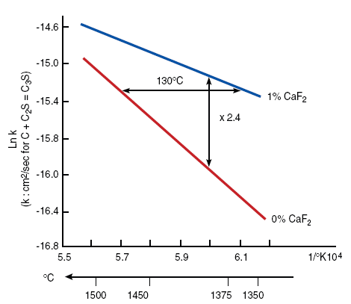
Mineralizing effects of F - kinetics
Reaction Rate
Increased rate or reduced temperature by F addition
25

Slide 26
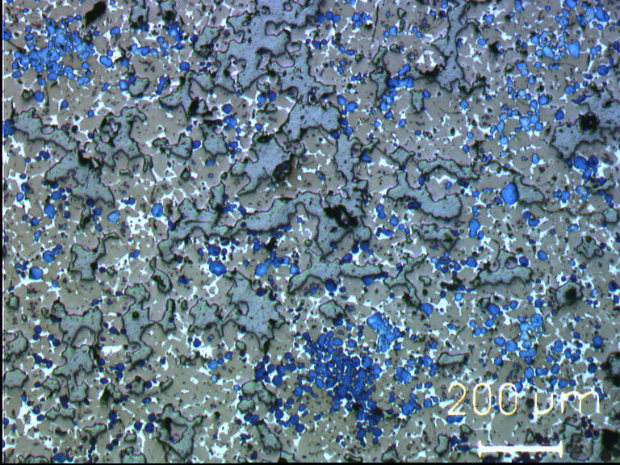
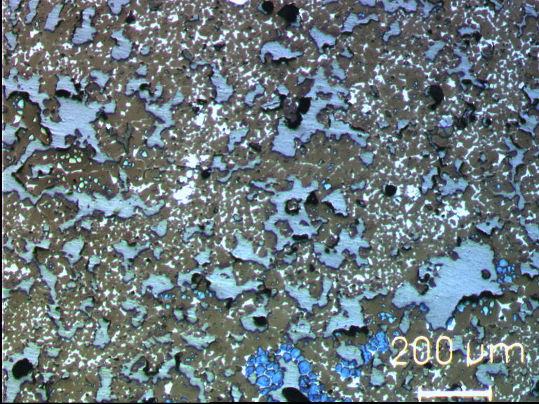
Example: Clinker microstructure Saraburi 1
normal
mineralized
26

Slide 27
Visualizing Improved Clinker Factor (e.g. Fès)
-4% clinker
-4% clinker
-4% clinker
+27%
+18%
+12%
27

Slide 28
Challenge: F acts as a set retarder
28

Slide 29
Experiences from industrial trials
Good preparation of an industrial mineralization trial is crucial
adequate dosing system
uniformity of fluorspar is more important than its purity
calibration of XRF for new clinker composition (higher LS)
F analysis is possible by ion selective electrode (ISE) and XRF, but not trivial
critical for ISE are sample dilution (matrix effect) and correct calibration when using direct measurement
critical for X-ray fluorescence is the calibration with plant specific standards
Good condition of kiln system is also important for burning of mineralized kiln feed
preheater efficiency (false air) and cleaning
impact of bypass operation
29

Slide 30
SO₃ and Alkalis
With increasing petcoke utilization, SO₃ in clinker is often very high
(>> 1 %)
SO₃ incorporation in clinker is facilitated by availability of alkalis:
Traditionally molar A/S ratio: ≥ 0.8, now < 0.5 is common!
At low molar A/S ratio (< 0.8)
SO₃ can be incorporated in Ca₂K₂(SO₄)₃
SO₃ can be incorporated in belite
Remaining SO₃ then forms anhydrite (CaSO₄)
Possible consequences:
Reduction in alite content in clinker (SO₃ stabilizes belite and retards belite conversion to alite) and therefore clinker reactivity
Need to adjust addition of soluble sulfate in cement (extreme cases)
30

Slide 31
Distribution of SO₃ in clinker phases
The form and distribution of sulfate in clinker is affected by the total percentage of SO₃ in clinker and by the alkali/sulfur ratio.
Orthorhombic
aluminates
Arcanite
Aphthitalite
Ca-Langbeinite
Anhydrite
A/S > 1
A/S = 1
A/S < 1
Quality issues
Aluminates = C₃A
Arcanite = K₂SO₄
Apthithalite = (K,Na)₂SO₄
Ca-Langbeinite = 2 Ca₂SO₄*K₂SO₄
Anhydrite = CaSO₄
Process & Quality Issues
31

Slide 32
Quality issues related to high sulfur content in combination with low A/S
Among silicates, belite builds significantly larger amounts of sulfur into its crystal structure compared to alite. Up to 4-5 times more SO₃ can be incorporated into belite compared to alite.
In the absence of alkalis and MgO, sulfates jointly with alumina are integrated into belite. This leads to
A decrease of the aluminate content
Stabilization of the belite and a reduced formation of alite
The incorporation of S⁶⁺ into belite can increase the belite content at the expense of alite by as much as 10-15 wt%.
High SO₃ content further reduce alite be absorption of CaO (Ca-langbeinite, anhydrite in extreme cases)
32

Slide 33
Influence of SO₃ on Aluminate content
33

Slide 34
Burnability test: Application for Raw Mix Optimization

Slide 35
Raw Meal Burnability
Burnability: How easy clinker forms
Burnability influences:
Kiln operation (heat consumption, refractory wear, volatility)
Degree of clinker burning and therefore reactivity of clinker
Burnability can be assessed by laboratory burnability tests
Determine optimal raw meal fineness
Determine main factors contributing to burnability
Burnability is primarily influenced by
LS and SR
Coarse quartz: > 32 µm
Coarse calcite: > 90 µm
A direct relationship between raw meal fineness and burnability is not mandatory
35

Slide 36
Holcim burnability test
The test is based on the isothermal burning at 1400 °C of raw meal nodules
The test allows the determination of the relative influence of the various material parameters, free from the influence of process technological disturbances.
Evaluation Free Lime %
very good 0 - 2
good 2 - 4
moderate 4 - 6
poor 6 - 8
very poor > 8
36

Slide 37
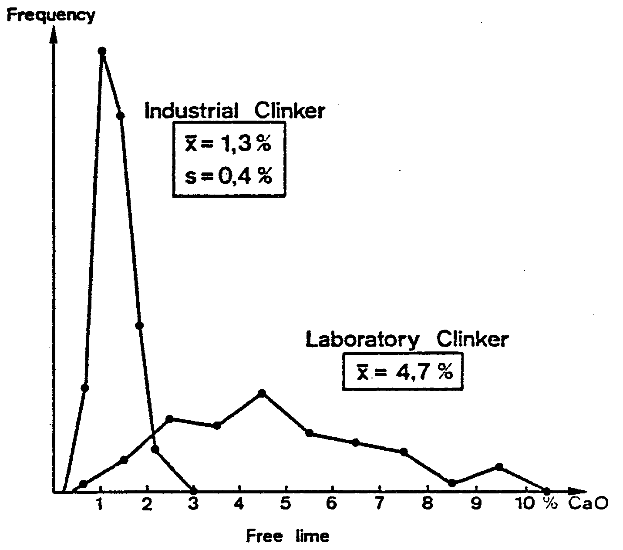
Hocim Burnability Test
37

Slide 38
Physiochemical Burnability Model
Calculation of the CaO_{f}-content, as expected to result from the burnability test, according to the formula:
with calculations for: LS = lime saturation SR = silica ratio Cc = percentage of critical calcite > 90 microns Q = percentage of critical quartz > 32 microns
CaO_{f} = 0.56*Q_{>32 μm} + 0.166*Cc_{>90 μm} + 0.356*LS + 0.804*SR - 33.886
38

Slide 39
Example of Physiochemical Burnability Model
Raw Meal Burnability
test
Quartz > 32 μm
Calcite > 90 μm
Chemistry
10
9
Very Poor
LS = 96.9
SR = 3.11
AR = 1.81
R90μm = 13.8%
8
Poor
LS = 95.7
SR = 2.85
AR = 1.79
R90μm = 12.7%
7
6
% free lime
Moderate
5
4
3
Good
2
1
Very Good
0
Test 1
Model 1
Test 2
Model 2
Rating
2002 Test
2002 Model
2003 Test
2003 Model
39

Slide 40
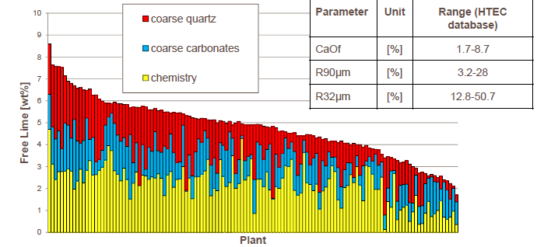
Burnability test: Industrial meals 2000 - 2015
40

Slide 41
Burnability: Mix Optimization Example 1
Situation
Wet process plant; excessively hard burning to drive off alkalis for meeting low-alkali requirement results in low-reactive clinker
Presently 2-component mix (limestone, shale), Na₂O-equiv. = 1.0 % (clinker basis)
Intention to modify mix by using additional components – in particular AR - to lower alkali level. This should allow softer burning and yield higher clinker reactivity.
41

Slide 42
Burnability: Mix Optimization Example 1
Possible mixes are:
Question What is the difference in burnability between the mixes with silica gel and silica dust respectively?
Components | Mix with silica gel | Mix with silica dust
Limestone | 76.3 | 76.4
Shale | 16.0 | 17.3
Silica gel | 5.8 | --
Silica sand | -- | 3.8
Pond ash | 0.5 | 0.5
Mill scale | 0.7 | 0.6
Bauxite | 0.7 | 1.4
LS (clinker) | 98.0
SR (clinker) | 2.60
AR (clinker) | 1.86
Na₂O-equiv. [%] | 0.75
42

Slide 43
Burnability: Mix Optimization Example 1
43

Slide 44
Burnability: Mix Optimization Example 1
Assessment
Silica gel is a favorable, amorphous silica corrective, having no negative impact on burnability: recommended material
Silica dust is crystalline quartz, negatively impacting burnability; should only be used as second choice
44

Slide 45
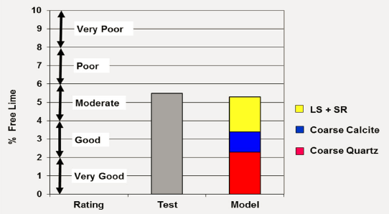
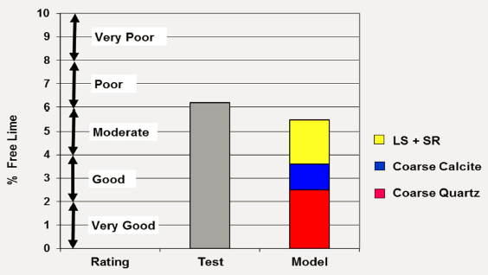
Example 2: Impact of raw meal fineneness
Raw meal line 1
Raw meal line 2
R90 = 15.30
R200 = 0.95
R90 = 16.70
R200 = 2.97
LS = 95 – 96
SR = 2.28 – 2.33
AR = 1.61 – 1.64
Coarser raw meal on R200 decreases burnability due to coarse quartz influence

Slide 46
Example 2: Impact of raw meal fineneness and correctives
46

Slide 47
Example: Mix Optimization and Cost Savings
Plant example of energy and cost savings as a net result of increasing raw meal fineness
47

Slide 48
Clinker Granulation and Coating Formation

Slide 49
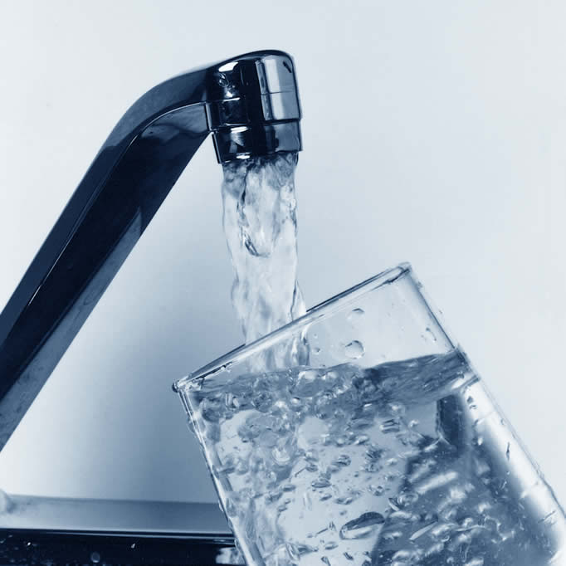
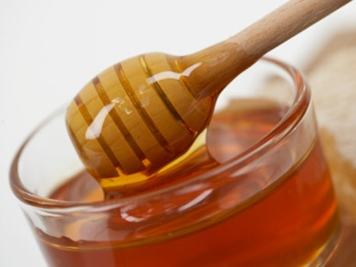
Liquid Phase: Viscosity
High Viscosity
Low Viscosity
Temperature
lower
higher
Alumina Ratio
higher
lower
Minor Elements
K₂O > Na₂O (increased SR, LS)
MgO < Na₂SO₄ < K₂SO₄ < SO₃
(Cl, F)
49

Slide 50
Effects of changed viscosity (qualitative)
Diffusion rate of ions is faster in low viscous liquids, promoting alite formation (mineralizing effect, e.g. F or SO₃).
High viscosity of the liquid phase improves the granulation (nodulization) of the clinker; low viscosity makes granulation more difficult.
Low viscous liquid phase infiltrates refractory linings faster, leading to premature failures
50

Slide 51
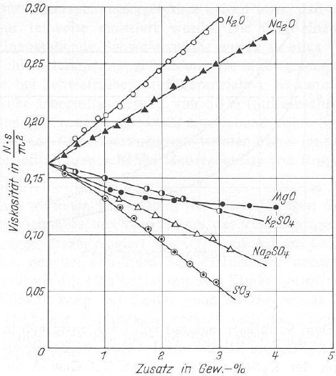
Influence of minor elements on viscosity
Higher viscosity
Lower viscosity
51

Slide 52
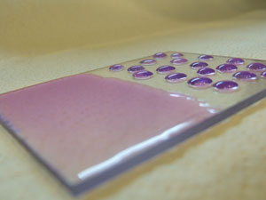
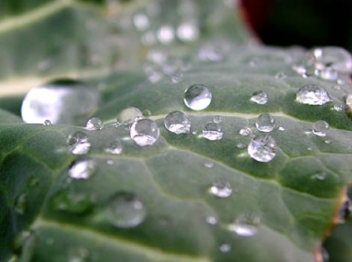
Liquid phase: Surface tension
High Surface Tension
Better nodule formation, lower dust.
Less coating due to less wetting of brick surfaces.
Low Surface Tension
Minor Elements: SO₃ > K₂O > Na₂O > MgO > P₂O₅
Very low AR
Temperature
higher
lower
52

Slide 53
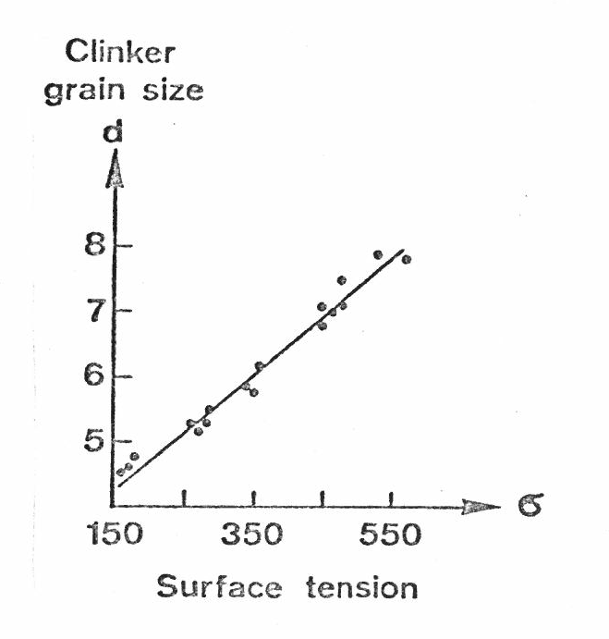
Effects of changed surface tension (qualitative)
High surface tension favors nodule formation and liquid penetration through pores (denser clinker nodules). The resulting clinker is coarser and less dusty.
High surface tension has less tendency to adhere to refractory linings, thus produce less coating.
Low surface tension enhances ‘wetting’ of particles and promotes alite formation.
Decreased surface tension favors growth of large alite crystals
53

Slide 54
Coating formation: Overview
Coating formation is influenced by quantity (SR) and viscosity (AR) of liquid phase.
AR
thick coating clinker ball or sinter ring formation (plenty of viscous melt phase)
very thin coating dusty clinker (little of viscous melt phase)
- 1.9
NORMAL
COATING
- 1.6
thin coating refractories attack (plenty of fluid melt phase)
thin coating
(little of fluid melt phase)
- 1.3
2.2
2.5
2.8
SR
54

Slide 55
Clinker Granulation
Impact of dusty clinker
Impairs kiln operation (heat transfer from flame)
Impairs cooler operation (transport, overheating)
Impairs clinker grindability
Chemical factors increasing tendency to dusty clinker:
Low liquid phase content: < 23 % (SR > 2.8)
High LS: LS > 98
High SO₃ content: SO₃ > 1.3
(Tentative values only, can differ in individual cases)
55

Slide 56
Clinker granulometry significantly impacts the production process
 | Very coarse clinker | Very fine clinker
Burnability | Center of grains difficult to burn | Poor heat transfer to center of clinker bed
Cooling | Slow cooling | Problems in cooler operation
Dust cycles |  | Enhancement of dust cycles
Availability | Crusher wear and blockages | Wear of cooler grates
Grindability | Hard to grind if ball charge not adapted | Hard to grind due to lack of thermal micro cracks
56

Slide 57
Clinker Granulation
Recommended sieves for granulation assessment: 1, 5, 8, 16 mm
Tentative criteria for dusty clinker: > 25 % passing 1 mm
Investigation of 16 industrial clinkers:
Sieve opening (mm) | Passing (%)
1 5 8 16 | x 10.2 32.8 46.7 74.5 | min. 0.4 15.1 24.9 59.1 | max. 30.9 53.5 64.1 92.4
57

Slide 58
Clinker Granulation
58

Slide 59
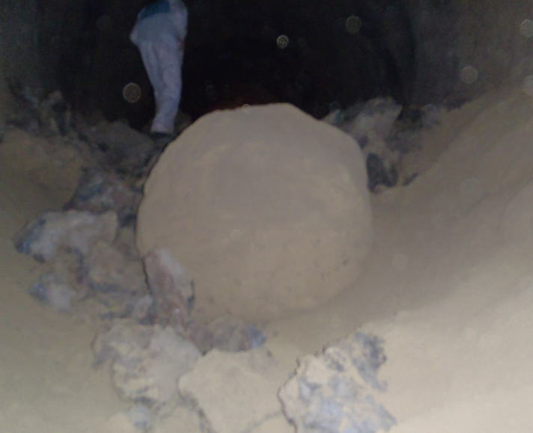
Clinker ball formation
Impact of clinker balls
Excessive clinker temperatures at cooler outlet
Cooler operation (blockages)
Chemical factors increasing tendency to ball formation
High liquid phase contents (> 27 %) and high viscosity (AR > 2.2)
Besides chemical factors, clinker ball formation is very much related to process condition (burner settings, sulfur volatilization, etc.)
59

Slide 60
Clinker Balls: Plant Example
The plant reduced a silica rich alternative resource (contaminated soil)
To compensate for lower SR, the iron corrective was reduced. This increased the AR.
Clinker ball formation occurred on several occasions and caused clinker cooler stoppages
Clinker ball formation coincided with peak-periods of liquid phase content and of high AR.
The phenomena disappeared when AR and SR could be brought back to initial levels.
60

Slide 61
Clinker Balls: Plant Example
Liquid phase
Silica ratio
Variations due to unsteady supply of AR
Alumina ratio
Periods of clinker ball formation
61

Slide 62
Clinker Microscopy: A Diagnostic Tool

Slide 63
Microscopy provides information which is not available from routine measurements
Clinker phases
Microstructure
content
morpho- logy
size
distribution
homo- geneity
porosity
Evaluation of
Process conditions
(e.g. raw meal properties, burning and
cooling conditions)
Clinker quality
(e.g. grindability, soundness, setting behavior, “strength development”)
63

Slide 64
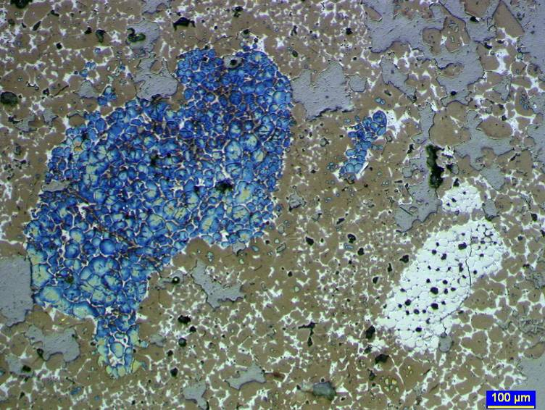
Example: Impact of raw meal preparation
Belite and free lime clusters due to oversized quartz and limestone grains => ineffective raw meal grinding.
64

Slide 65
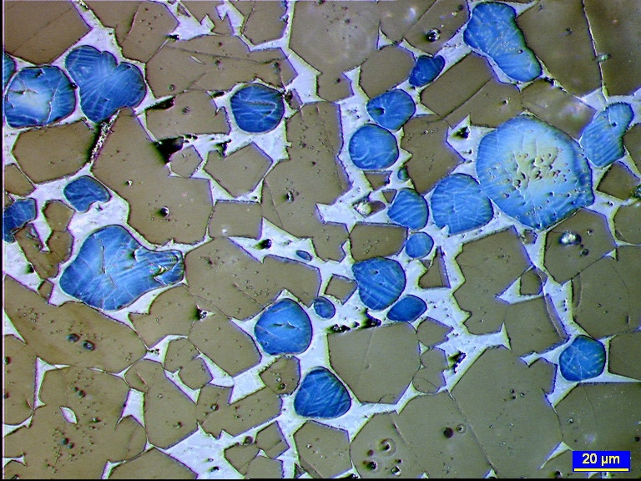
Example: Investigations of cooling conditions
Small sized interstitial mass and no alite decomposition are characteristic for effective clinker cooling.
65

Slide 66
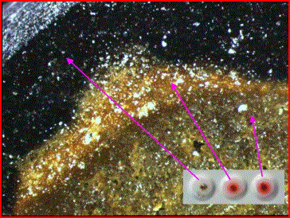
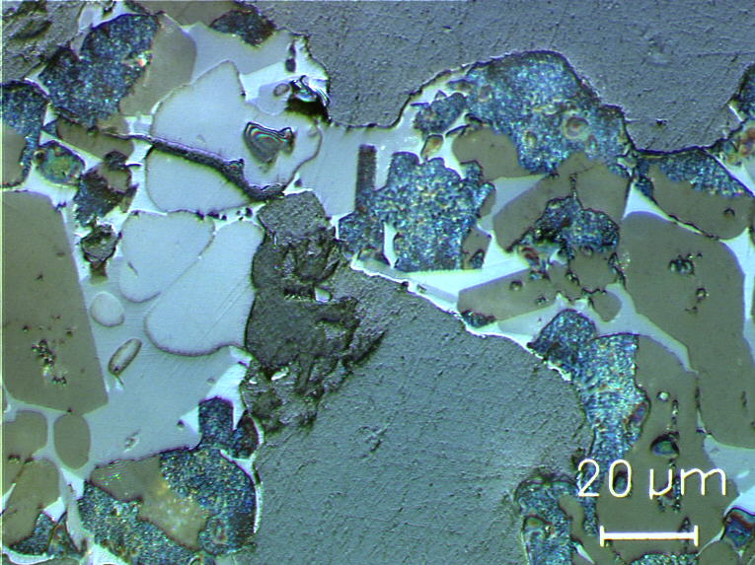
Example: Impact of reducing conditions
Practical, simple test for reducing conditions: “Magotteaux Test”
Microscopy can show effects of reducing conditions, e.g. decomposition of alite starting from edge of pores (access of gas)
66

Slide 67
Microscopy: Impact of P₂O₅
4.2% P₂O₅ in belite
67

Slide 68
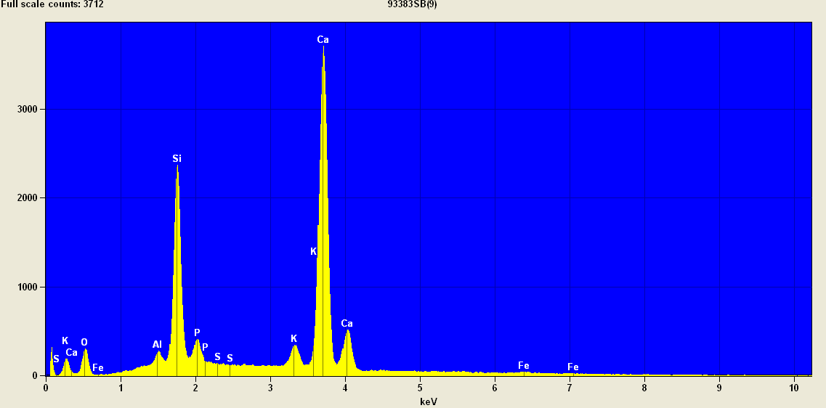
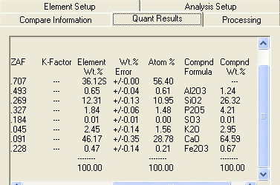
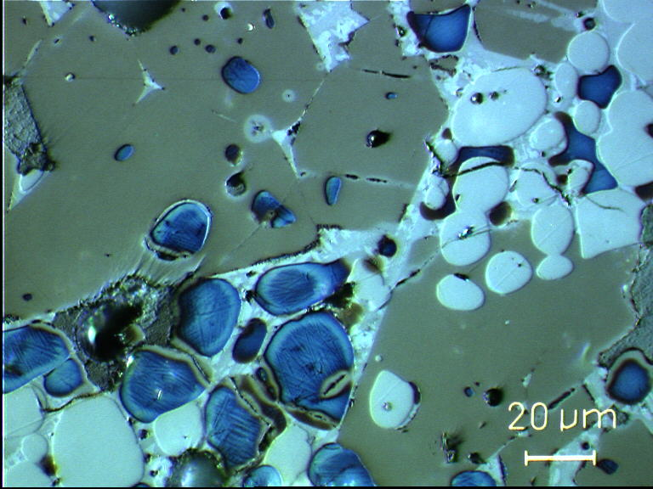
Microscopy can be supported by SEM measurements
Spotanalysis of belite in direct contact with free lime
68

Slide 69
Conclusions

Slide 70
Conclusions
Investigate and exploit the potential for raw mix and clinker optimization with regard to
Improve the burning behavior
Improve product quality
Reduce materials cost
Consider the use of alternative materials in this context
Make use of powerful diagnostic and prognostic tools to assess the potential of optimization possibilities
70

